Slide 1

Technical Schedule
Giuseppe
Macca
Analytics Algorithms

Slide 2

Technical Schedule
Name: Relebohile Mofokeng
Citizenship: South Africa
born: Oct 23, 2004
Position: MC, AMR, AML, AMC
Foot: RIGHT
Height: 1,64 M
Club: Orlando Pirates

Slide 3
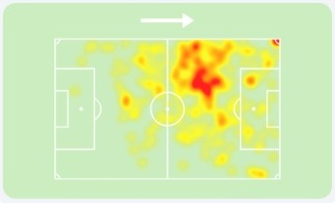
SEASON HEATMAP

Slide 4
PHYSICAL
Acceleration | 65
Agility | 65
Balance | 40
Jumping Reach | 15
Natural Fitness | 60
Pace | 65
Stamina | 65
Strength | 25

Slide 5
MENTAL
Aggression | 55
Anticipation | 40
Bravery | 40
Composure | 40
Concentration | 25
Decisions | 45
Determination | 45
Flair | 65
Leadership | 5
Off the Ball | 50
Positioning | 40
Teamwork | 40
Vision | 50
Work Rate | 55

Slide 6
TECHNICAL
Corners | 35
Crossing | 60
Dribbling | 65
Finishing | 55
First Touch | 65
Free Kick Taking | 35
Heading | 20
Long Shots | 45
Long Throws | 35
Marking | 25
Passing | 40
Penalty Taking | 30
Tackling | 30
Technique | 65

Slide 7
BEST ROLES (SUITABLE)
Winger (Support)60.2
Winger (Attack)59
Inverted Winger (Support)56.4
Inverted Winger (Attack)56.1
Inside Forward (Attack)54.9

Slide 8
STATUS ABILITY GLOBAL
51/100
OVERALL PREVIEW
70/100

Slide 9
The parameters indicate that it is similar to
Tomás Rambert AML Independiente
Tobías Medina AMC San Lorenzo
Jorge Ortiz AMR, AML Univ. Católica

Slide 10
current player value
€ 364,370
potential future value
€ 1,614,022
Giuseppe Macca

